Slide 1
ITG Workshop on 5G antennas
13 November 2018, University Munich / Germany
Regulatory considerations
Thomas Weilacher
Chairman ECC Working Group Frequency Management
thomas.weilacher@bnetza.de
1

Slide 2

Structure of the ECC
Structure of the ECC
Electronic
Communications Committee
Chairman: C. Woolford (G)
Vice-Chairmen: S. Pastukh (RUS)
J. Afonso (POR)
Steering Group
European
Communications Office
Director: P. Christensen (DNK)
Deputy Director: B. Espinosa (F)
WG CPG
WG FM
WG SE
WG NaN
ECC PT1
Conference
Preparatory Group
Frequency
Management
Spectrum
Engineering
Numbering
and Networks
IMT-Matters
Chairman:
A. Kühn (D)
Vice-Chairmen:
G. Osinga (HOL)
A. Kholod (SUI)
Chairman:
T. Weilacher (D)
Vice-Chairmen:
S. Talbot (G)
V. Durepaire (F)
Chairman:
J. André (F)
Vice-Chairmen:
J. Duque (POR)
k. Bejuk (HRV)
Chairman:
J. Vallesverd
(NOR)
Vice-Chairmen:
E. Greenberg (G)
V. Krastev (D)
Chairman:
S. Green (G)
Vice-Chairmen:
V. Milas (GRC)
E. Tonkikh (RUS)
Updated: October 2018

Slide 3
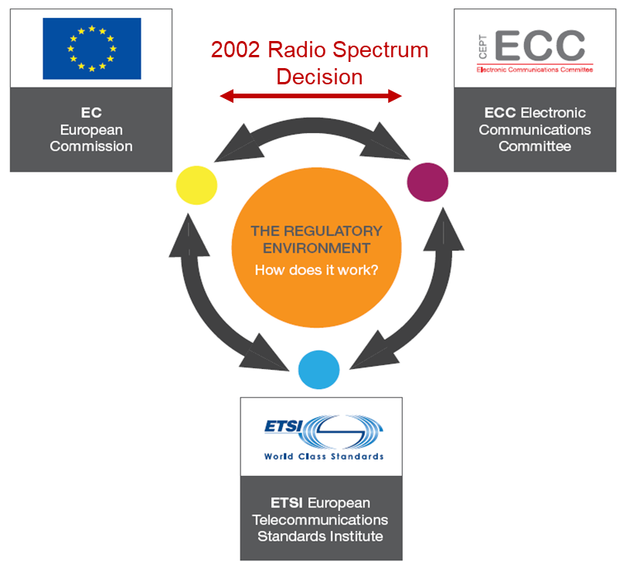
Radio regulatory environment in Europe
At national level, radio spectrum is managed by national administrations.
At European level, the European Commission (EC), ETSI, and the Electronic Communications Committee (ECC) of the European Conference of Postal and Telecommunications Administrations (CEPT¹⁾) cooperate on aspects related to the regulatory environment for radio equipment and spectrum.
1) CEPT: Conférence Européenne des Administrations des Postes et des Télécommunications

Slide 4
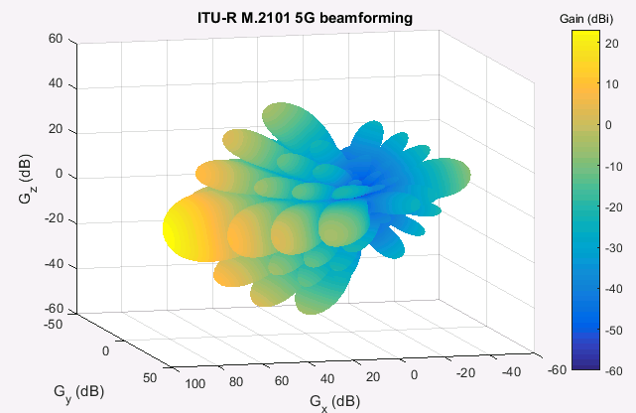
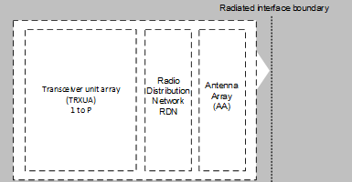
5G AAS - Introduction
Active Antenna Systems (AAS) are used in 5G for high gain directional beamforming to maximise the user data rates and the coverage.
Multiple transceivers and antennas are integrated in one single array:
Non-AAS architecture:
AAS-Architektur:

Slide 5
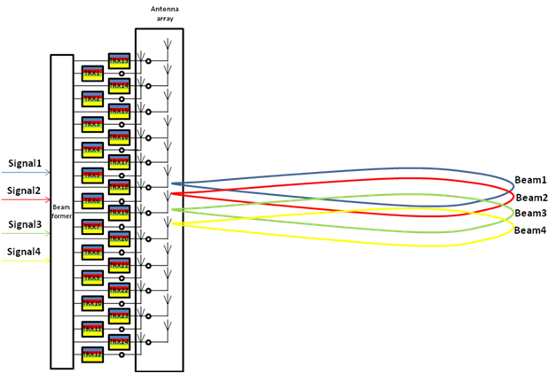
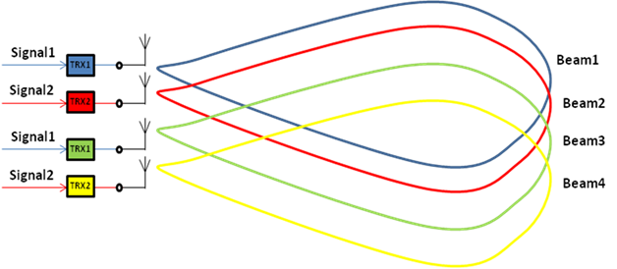
Comparison - AAS und Non-AAS
4 way MIMO Non-AAS System with 4 TRX
4 way MIMO AAS System with 24 TRX
Source: Huawei

Slide 6
Regulatory challenges caused by AAS technology
Difficulty to determine the maximum antenna gain because of the dynamic beamforming – How can e.i.r.p. limits be specified?
No antenna connectors – How can conducted power limits be determined (e.g. for unwanted emissions (spurious emissions))?
Radio compatibility problems – How can the direction and the shape of the transmission characteristics be determined, especially in spurious emission frequency ranges?
No possibilities for field measurements (monitoring)?
→ CEPT/ECC (FM22, ECC PT1) is dealing with these questions

Slide 7
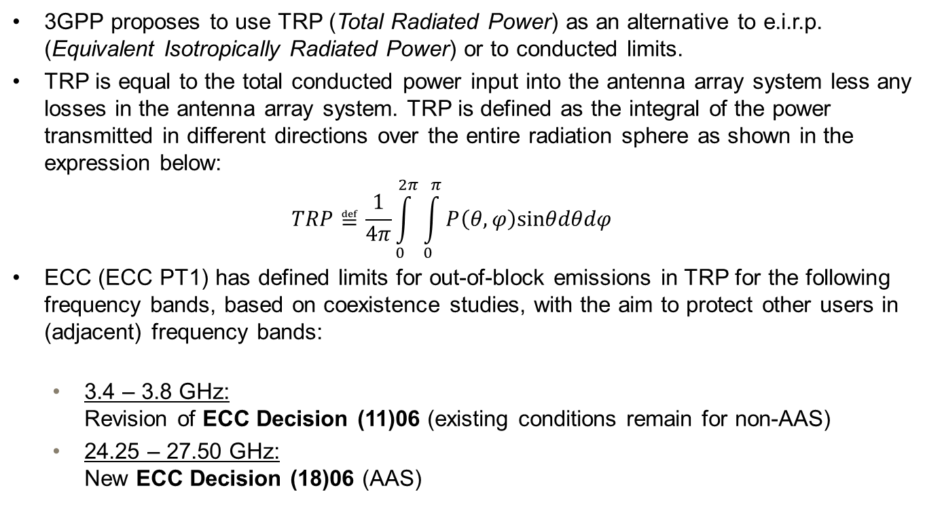
TRP (Total Radiated Power)
3GPP proposes to use TRP (Total Radiated Power) as an alternative to e.i.r.p. (Equivalent Isotropically Radiated Power) or to conducted limits.
TRP is equal to the total conducted power input into the antenna array system less any losses in the antenna array system. TRP is defined as the integral of the power transmitted in different directions over the entire radiation sphere as shown in the expression below:
  $$TRP≝\frac{1}{4π}\int_{0}^{2π}{\int_{0}^{π}{P\left(θ,φ\right)sinθdθdφ}}$$
ECC (ECC PT1) has defined limits for out-of-block emissions in TRP for the following frequency bands, based on coexistence studies, with the aim to protect other users in (adjacent) frequency bands:
  3.4 – 3.8 GHz:
  Revision of ECC Decision (11)06 (existing conditions remain for non-AAS)
  24.25 – 27.50 GHz:
  New ECC Decision (18)06 (AAS)

Slide 8
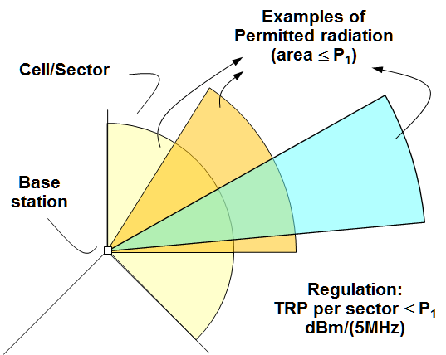
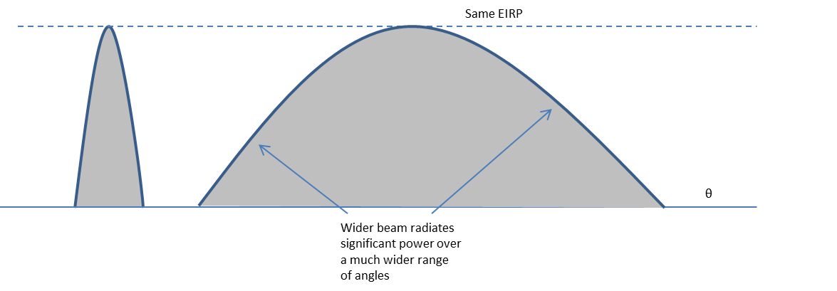
TRP vs. e.i.r.p. limits – interference consideration
By using a TRP limit the same power can either be distributed over a larger area or concentrated within a narrower beam.
By using an e.i.r.p. limit more power can be distributed over a larger area, by still applying the e.i.r.p. limit.
TRP provides a higher degree of flexibility for the network roll-out, by not changing the average interference environment.

Slide 9
Limits for the spurious emissions
General limits for unwanted emissions in the spurious domain (frequency separation larger than 2.5 * channel bandwidth) are specified in ERC Recommendation 74-01.
ECC (SE PT 21) is revising this Recommendation, especially with regard to the limits for 5G AAS.
Tests with available 5G equipment have shown that the applicability of the current limit of -30 dBm/MHz above 1 GHz can probably not be ensured.
SE PT 21 is considering alternative solutions on how to specify the limits, especially regarding possibilities for limits for systems with various channel bandwidths.
Possibilities (measurement methods) for TRP measurements in the field are under discussion.
Schedule: until May 2019.

Slide 10
Spectrum regulation for the 5G pioneer bands (3.5 GHz, 26 GHz)
Available for the public on the ECC website (https://www.cept.org/ecc/deliverables/)
ECC Decision (11)06 (revised version, 26 Oct. 2018)
3400 - 3800 MHz;
Harmonised technical conditions (BEM (Block Edge Mask), LRTC (Least Restrictive Technical Conditions));
Bandplan based on TDD (Time Division Duplex), multiples of 5 MHz blocks;
Based on radio compatibility and coexistence studies (ECC Report 281 (technical conditions), ECC Report 287 (defragmentation));
E.g. coexistence with EESS earth stations, protection of military radars below
3400 MHz;
CEPT Report 67 (basis for EU wide harmonisation measure, adoption of the Commission Implementing Decision by the RSC (Radio Spectrum Committee) planned for Dec. 2018);
Additional ECC Report under development (coexistence in non-synchronised and semi synchronised networks (toolbox)).

Slide 11
Spectrum regulation for the 5G pioneer bands (3.5 GHz, 26 GHz)
ECC Decision (18)06 (06 July 2018, corrected on 26 Oct. 2018)
24.25 – 27.50 GHz;
Harmonised technical conditions (BEM (Block Edge Mask), LRTC (Least Restrictive Technical Conditions));
Bandplan based on TDD (Time Division Duplex), 200 MHz blocks;
Based on radio compatibility and coexistence studies (CEPT Report 68);
E.g. protection of satellite services (EESS/SRS/ISS/FSS), radio astronomy service (RAS) and the fixed service (radio relay systems);
Review of the conditions within 5 years;
New ECC Recommendation (19)01 under development (coexistence with earth stations);
The band 24.25 - 27.50 GHz is not suitable for links between base stations (MFCN) and drones;
CEPT Report 68 (basis for EU wide harmonisation measure, adoption of the Commission Implementing Decision by the RSC (Radio Spectrum Committee) planned for March 2019);
Additional ECC Report under development (coexistence in non-synchronised and semi synchronised networks (toolbox)).

Slide 12
Public consultation
The following draft ECC Decisions, draft ECC Reports and draft ECC Recommendation are currently under public consultation (until 11 December 2018):
Link:
https://www.cept.org/ecc/tools-and-services/ecc-consultation
ECC Decisions (drafts)
Revised version of ECC Decision (06)01 on the paired 2 GHz bands (1920 - 1980 MHz / 2110 - 2170 MHz);
Revised version of ECC Decision (06)13 on the 900 MHz (880 - 915 MHz / 925 - 960 MHz) and 1800 MHz (1710 - 1785 MHz / 1805 - 1880 MHz) bands; no BEM so far, additional references to the 5G standards.

Slide 13
Public consultation
ECC Reports (drafts)
ECC Report 296 (synchronisation within 3400 - 3800 MHz),
this Report supplements the results of ECC Reports 216 and 281 and should support the implementation activities of the national spectrum administrations;
ECC Report 297 (basis for the amendments in ECC Decision (06)13 on the 900 MHz and 1800 MHz bands); two-step approach; references to the 5G standards for the time being, BEM should be developed until June 2020;
ECC Report 298 (basis for the amendments in ECC Decision (06)01 on the paired
2 GHz bands), a 300 kHz guard band at the band edges (as before) is under discussion, comments also on that are required.
ECC Recommendation (draft)
ECC Recommendation (19)01 (coordination between 5G at 26 GHz (25.5 - 27 GHz) and SRS/EESS earth stations).

Slide 14
CEPT 5G Roadmap
    CEPT 5G Roadmap
    https://cept.org/ecc/topics/spectrum-for-wireless-broadband-5g
    The aim is, besides the revision of the regulations for the bands 3.4 - 3.8 GHz, 26 GHz, 900/1800 MHz and the paired 2 GHz bands, also to review the ECC Decisions for MFCN in other bands to ensure suitability for 5G:
    MFCN in 700 MHz, 800 MHz, 2.3 GHz, 2.6 GHz;
    Also vertical market sectors (traffic, PPDR (draft revised ECC Decision (16)02 on 400 and 700 MHz bands was amended), railways (draft ECC Report 294 will be in the public consultation until 23 Nov. 2018 (900 MHz, 1900 MHz, 2290 - 2400 MHz are under discussion))) are under consideration;
    60 GHz range (57 - 66 GHz (in the future possibly until 71 GHz)), part of the 7th update of the Commission Decision on SRD (draft CEPT Report 70), usage in Europe based on general licences;
    Workshop on vertical market sectors in Copenhagen in May 2019 under preparation (final date, see ECC calendar: https://www.cept.org/ecc/meeting-calendar/)

Slide 15
Contacts
ECO contact: | Internet: www.cept.org/ecc
ECO Nyropsgade 37, 4 DK-1602 Kopenhagen Dänemark Tel: +45 33 89 63 00 eco@eco.cept.org
WG FM contact:
Thomas Weilacher
thomas.weilacher@bnetza.de
Tel: +49 6131 183119

